Slide 1

A Look Into Covid-19 Hospitalizations
Brooke Benton, Lay Len Ching, Oreoluwa Williams

Slide 2
Covid-19 Hospitalization Data
Source: Open Data Pennsylvania
Each observation corresponds to a county in PA
Data was collected from April 2020 - December 2020
Our goal: Examine change in variables corresponding to COVID hospitalizations over time

Slide 3
The Method
The Updated Code:
covid_hospitalizations |>
mutate(proportion_covid_icu = covid_icu / icu_total) |>
filter(county== c("Allegheny", "Jefferson", "Fayette", "Delaware", "Philadelphia", "Westmoreland")) |>
ggplot(aes(x = date, y = proportion_covid_icu, color=county, color=c("purple", "tomato", "thistle", "orange", "seagreen"))) +
geom_line()+
facet_wrap(~county)
:
Time series graph for each county
Visualize how proportion of Covid patients changes over time for the respective location
Representative sample of six counties
Color to make the graphs easier to view
New variable - proportion_covid_icu
Determines the proportion of ICU patients with COVID by month

Slide 4
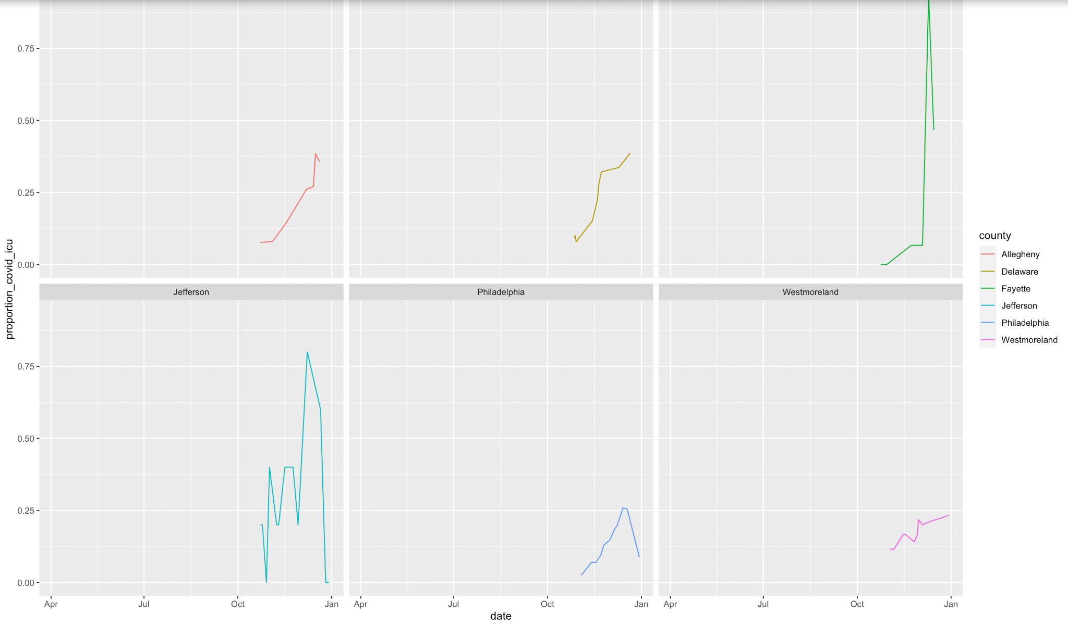
Updated Time Series

Slide 5
How Does the Availability of ICU Beds Change Over Time?

Slide 6
Visualizing ICU Bed Availability
library(sf) to encode spatial vector data
library(Lubridate) to create month column
Data Transformation
New column “month”
Converted date column to `Date` objects.
Grouped data by county and month.
Calculated the median ICU beds available per month for each county.

Slide 7
Resource allocation is crucial for effective response in times of emergency
Initial High Availability: Counties like Allegheny, Philadelphia, and Montgomery start with the highest bed availability
Counties may have fewer serious COVID-19 cases initially or better-prepared healthcare infrastructure
Big cities: PGH, Philly
Decreasing Trend: General decrease in bed availability over time across all counties
Increasing COVID-19 cases or other healthcare demands are progressively occupying available beds
Resource Allocation: The data suggests a need for careful resource allocation to manage decreasing bed availability

Slide 8
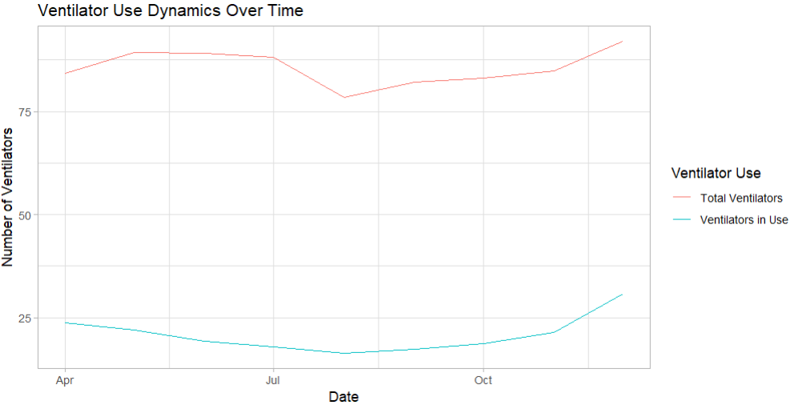
How do the Dynamics of Total Ventilators and Ventilator Use Change Over Time?

Slide 9
Methods for Analyzing Ventilator Dynamics
Methods:
Data grouped by month to aggregate ventilator usage and availability using the floor_date function which rounds down dates to the nearest month.
Calculated the mean values of ventilators in use `vents_use` and total ventilators `vents` for each month. This provides an average value that represents the overall trend.
na.rm = TRUE ignores missing values.
Visualization:
Line plot created to visualize `vents_use` & `vents` over time.

Slide 10
Share Insight
Insight: Over time, there were clear trends in ventilator use, with variations in the number of ventilators available and in use. In July we can see that the total ventilators and ventilators in use fall and rise back in August.
Conclusion: Monitoring the use of ventilators is essential for controlling critical care resources. Hospitals can make sure patients in critical condition have the equipment they need by using this information to optimize ventilator distribution.

Slide 11
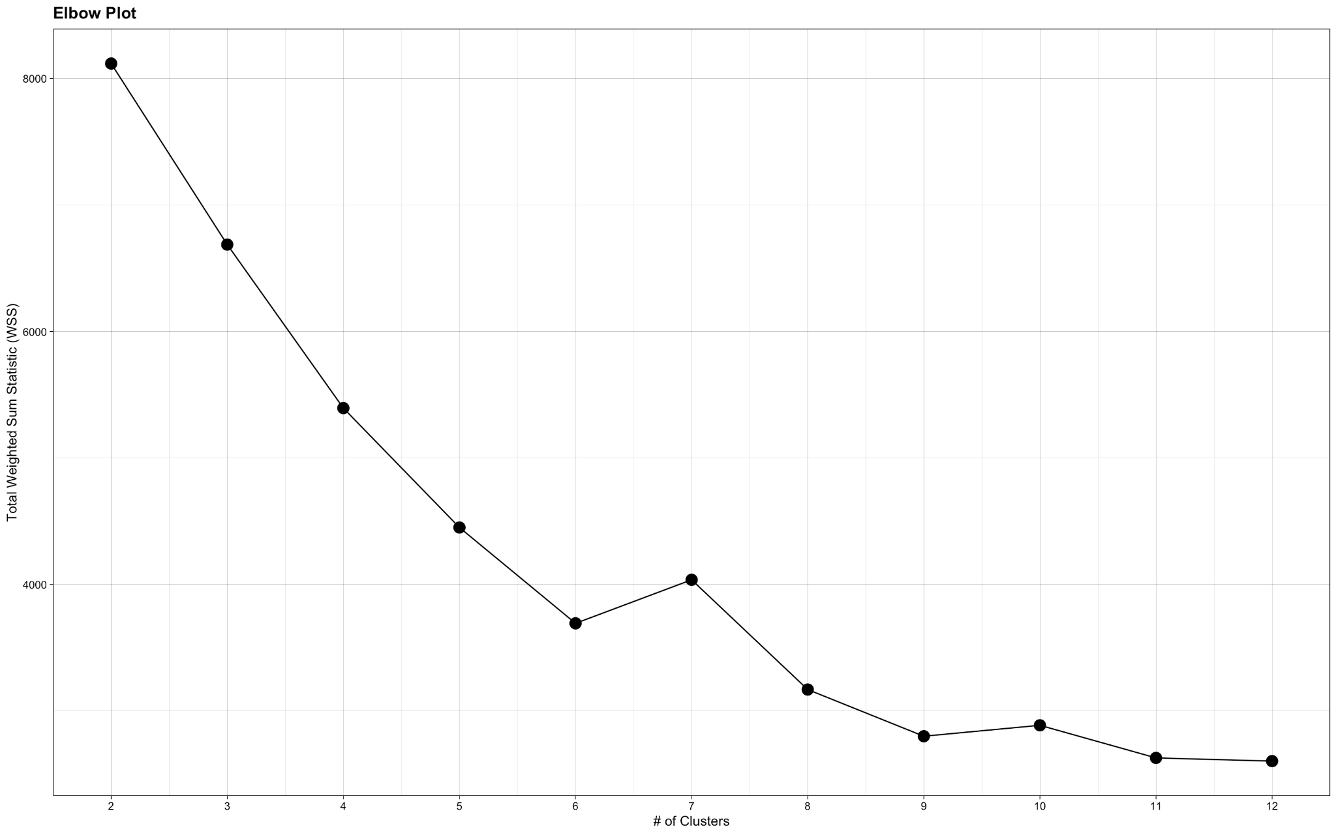
Elbow Plot
Notes:
K-means++ clustering algorithm to group data based on similar characteristics.
Total Weighted Sum of Squares (WSS)
Clusters ranging from 2 to 12
Plotted WSS against the number of clusters to identify the "elbow" point
Result: 7 Clusters

Slide 12
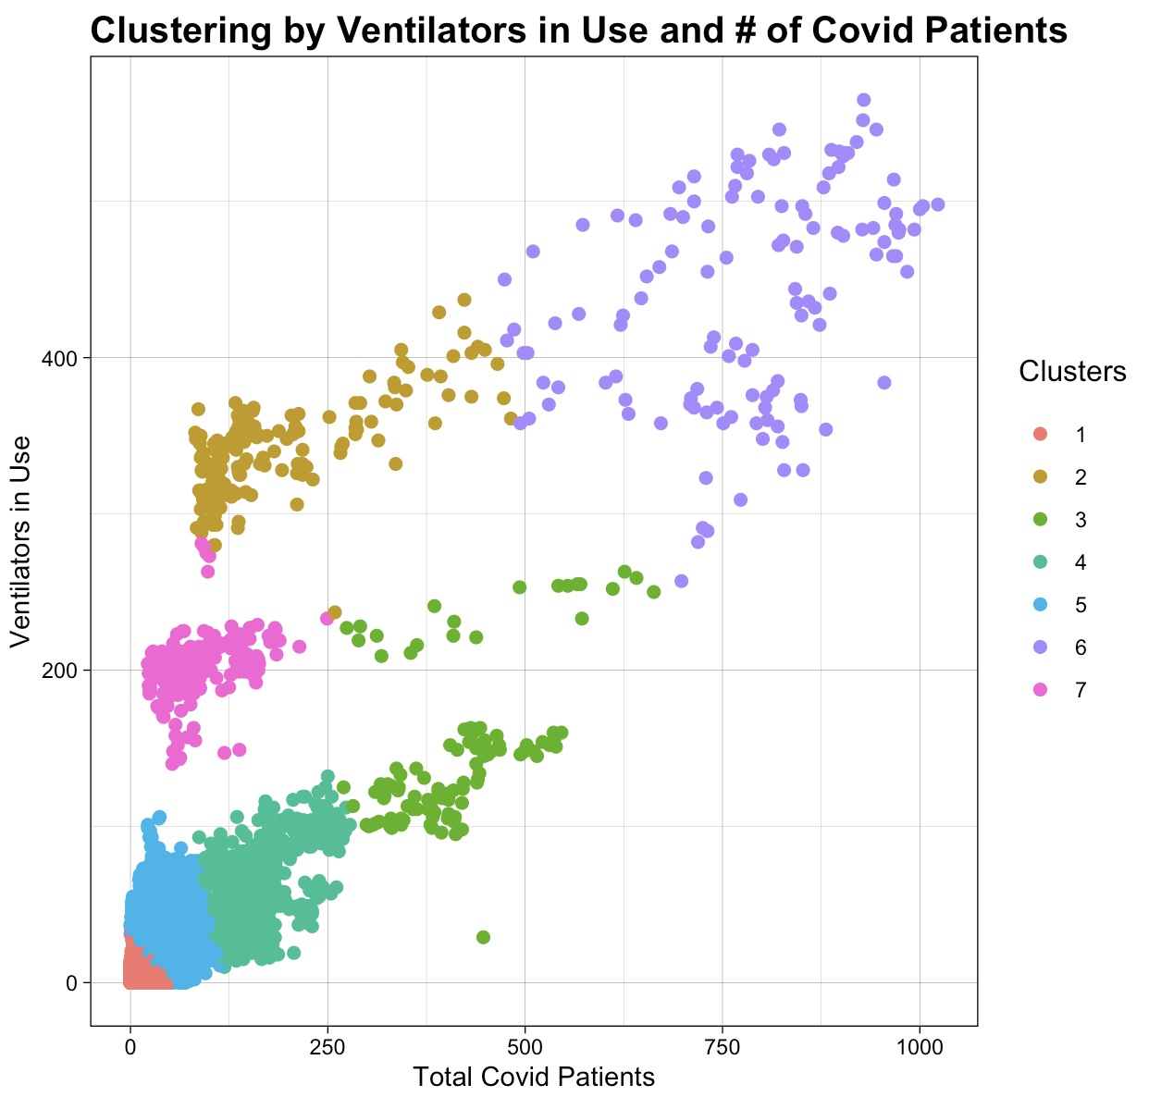
Notes:
Why K-means++ clustering?
Over K-means == more efficient and accurate due to one original center plotting
Over hierarchical clustering == less computer power + better for larger datasets
High COVID Patients, High Ventilator Use:
Regions with more severe outbreaks and healthcare strain.
Low COVID Patients, Low Ventilator Use:
Less severe impacts.

Slide 13
Clustering
Applied k-means++ clustering with 7 clusters.
Visualizing
Scatter plot showing relationship between # of COVID patients and ventilators in use.
Colored points by assigned clusters → visualize data grouping.
Result
The scatter plot shows distinct clusters, indicating groups of counties with similar hospitalization characteristics.

Slide 14
Evolving Dynamics of COVID-19 Hospitalizations
Seasonal and Environmental Factors
Spike in ICU admissions approaching winter
Seasonal factors (cold weather, increased indoor activity) may contribute to higher transmission rates of COVID-19 and force people to spend more time indoors
Trend in Bed Availability
Varying levels of preparedness
Some counties having higher bed availability, due to(fewer initial serious COVID-19 cases, better healthcare infrastructure readiness).
Over time, general decrease in bed availability is observed as a result of the
Growing strain on healthcare resources (increasing COVID-19 cases and possibly other healthcare demands)
Ventilator Utilization
Patterns point to the importance of monitoring and optimizing critical care resources
Variations in availability and use highlight fluctuations in patient severity and critical care needs
Notes:
Limitations:
Hard to establish seasonality or trends without multiple years of data
Mostly quantitative data

Slide 15
Further: Influencing policy and healthcare strategies
Regional Disparities
Examine how healthcare resource availability varies across different demographic and socioeconomic groups within counties
Inform policies aimed at reducing disparities.
Targeted interventions to improve access to healthcare services and resources in underserved communities.(telehealth services)
Resource Allocation Strategies
Building on the cluster analysis, policymakers can refine resource allocation strategies.
Counties identified with high COVID-19 patient numbers and ventilator use could receive priority in resource allocation
Additional ventilators
ICU beds
Healthcare personnel.

Slide 16
Any Questions?

